Slide 1
Apache Kafka Terminologies and Concepts
Basically, Kafka architecture contains few key terms, like topics, producers, consumers, brokers and many more. To understand Apache Kafka in detail, we must understand these key terms first.
So, in this video, we will learn all these Kafka Terminologies which will help us to build the strong foundation of Kafka Knowledge.

Slide 2
Apache Kafka Terminologies and Concepts
Broker
Producers
Connector API
Log Anotomy
Message Ordering
Consumers
Offset
Partitions
Consumer Group
Topics

Slide 3
Apache Kafka Terminologies and Concepts
Replicas
Node
Follower
Data Log
Leader
Message
Cluster

Slide 4
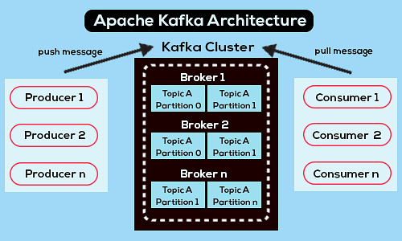
Apache Kafka Architecture – Cluster

Slide 5
Apache Kafka
Kafka Terminologies
1. Kafka Broker
There are one or more servers available in
Apache Kafka cluster, basically, these servers (each) are
what we call a broker.
2. Kafka Topics
Basically, Kafka maintains feeds of messages in categories. And, messages are stored as well as published in a category/feed name that is what we call a topic. In addition, all Kafka messages are generally organized into Kafka topics.
3. Kafka Partitions
In each broker in Kafka, there is some number of partitions. These Kafka partitions in Kafka can be both a leader or a replica of a topic. So, on defining a Leader, it is responsible for all writes and reads to a topic whereas if somehow the leader fails, replica takes over as the new leader.

Slide 6
Apache Kafka
Kafka Terminologies
4. Kafka Producers
In simple words, the processes which publish messages
to Kafka is what we call Producers. In addition, it publishes data
on the topics of their choice.
5. Kafka Consumers
The processes that subscribe to topics and process as well as read the feed of published messages, is what we call Consumers.
6. Offset in Kafka
The position of the consumer in the log and which is retained on a per-consumer basis is what we call Offset. Moreover, we can say it is the only metadata retained on a per-consumer basis.

Slide 7
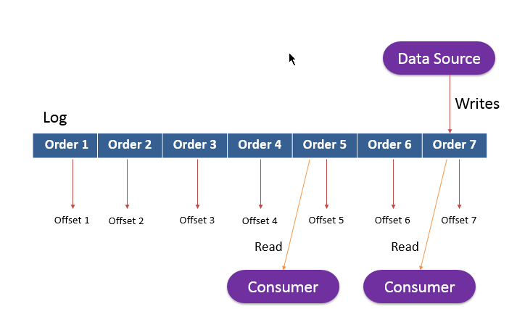
Apache Kafka
Kafka Terminologies
7. Kafka Consumer Group
Basically, a consumer abstraction offered by Kafka which generalizes both traditional messaging models of queuing and also publish-subscribe is what we call the consumer group. However, with a consumer group name, Consumers can label themselves.
8. Kafka Log Anatomy
A log is nothing different but another way to view a partition. Basically, a data source writes messages to the log. Further, one or more consumers read that data from the log at any time they want.

Slide 8
Apache Kafka
Kafka Terminologies
9. Kafka Message Ordering and Client Acknowledgments
In Kafka, the order of the messages delivered from a
certain partition and messages received by the partition is same.
10. Node in Kafka
In the Apache Kafka cluster, a node is a single computer.
11. Kafka Cluster
A group of computers which are acting together in order to achieve a common purpose is what we call a cluster. In Kafka also, it has the same meaning i.e. a group of computers, each having one instance of Kafka broker.
12. Kafka Replicas
Here, the word replica refers to a backup. That means a replica of a partition is a “backup” of a partition. Basically, we use replicas in order to prevent data loss, they never read or write data.

Slide 9
Apache Kafka
Kafka Terminologies
13. Kafka Message
In one line, Message in Kafka is an information which travels from the producer to a consumer through Apache Kafka.
14 Kafka Leader
A node which is responsible for all reads and writes for the given partition is what we call a Kafka Leader. So, every partition consists of one server, which acts as a leader.
15. Follower in Kafka
Simply putting, a node that follows leader instructions is what we call a follower. The basic usage of a follower is, if any leader fails, any of these followers will automatically become the new leader. However, it plays as the normal consumer, which pulls messages and also updates its own data store.

Slide 10
Apache Kafka
Kafka Terminologies
16. Kafka Data Log
Messages are preserved through Kafka, especially for a considerable amount of time. That means consumers can read as per their convenience.
Since Kafka is configured to keep messages for 24 hours but somehow consumer is down for time greater than 24 hours, in that case, the consumer will lose messages. Still, it is possible to read that message from last known offset, only if the downtime on part of the consumer is just 60 minutes.
17. Kafka Connector API
The API which permits to build as well as run reusable consumers or producers that connects existing applications or data systems to Kafka topics, we use the Connector API.

